Slide 1
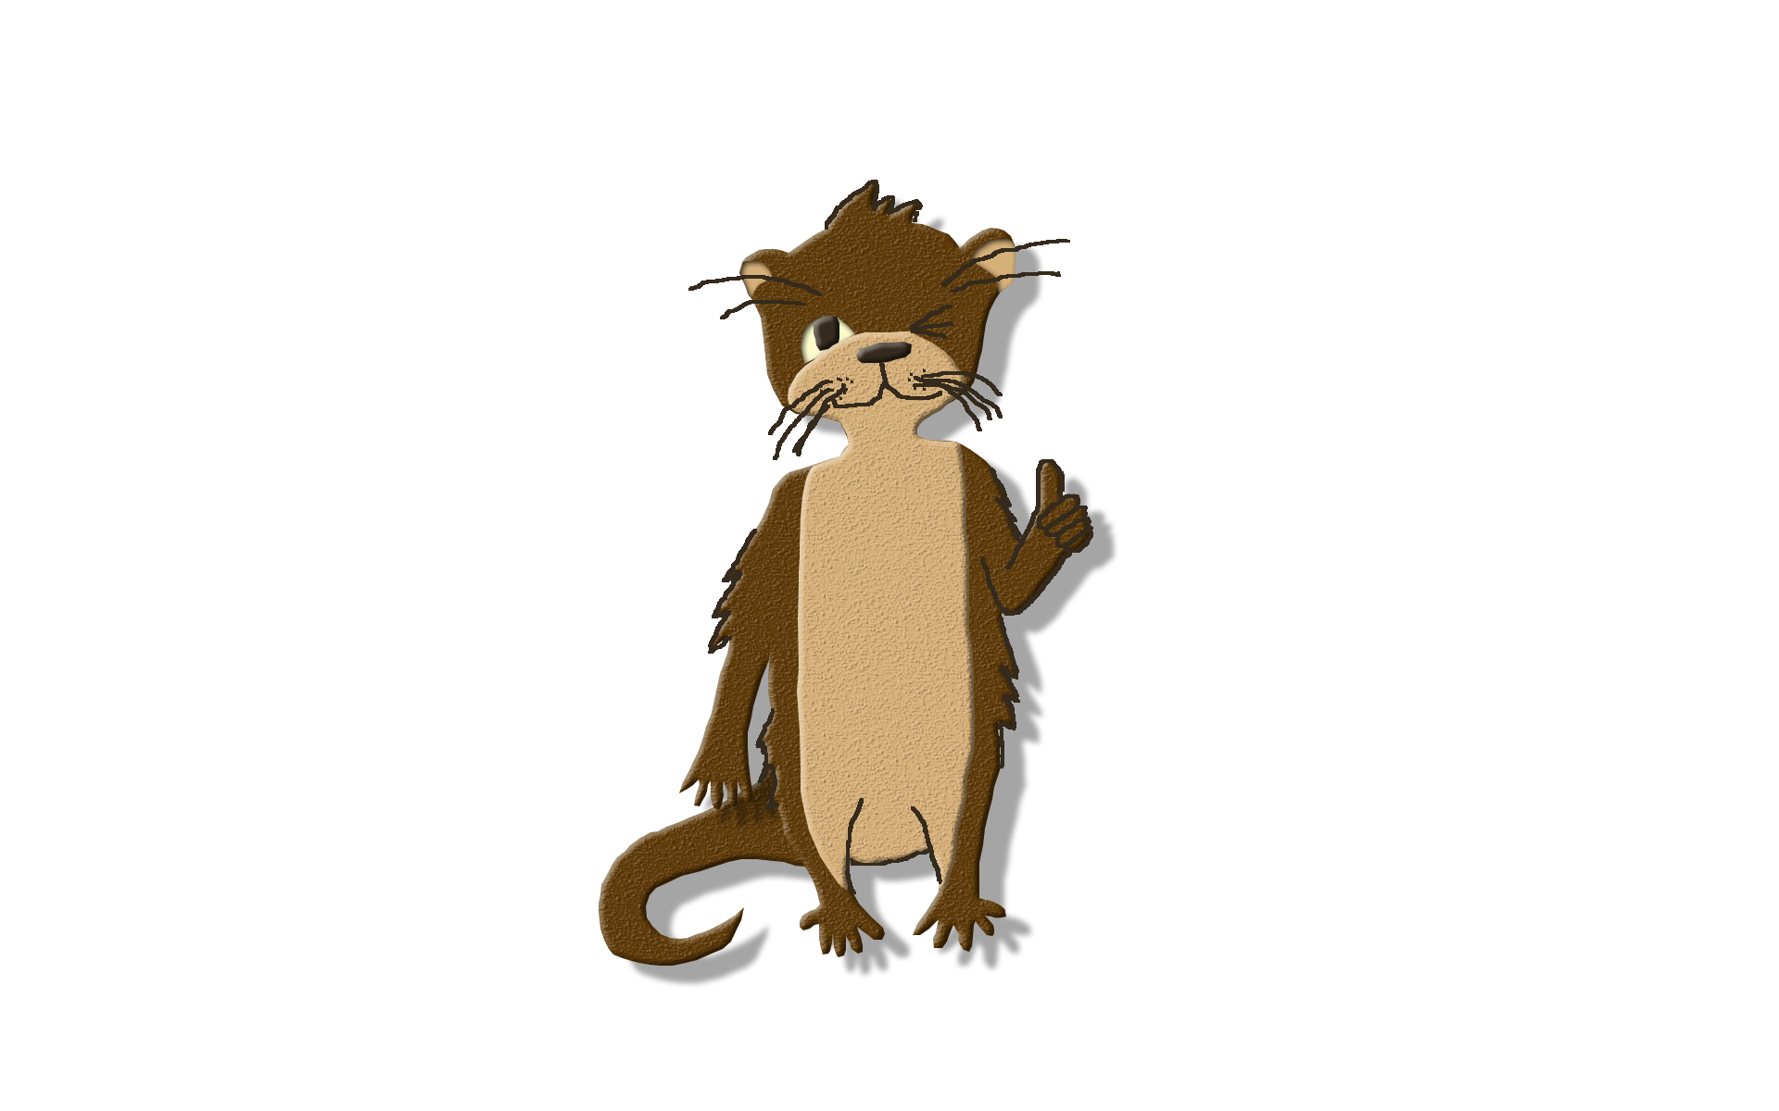
EcoScapes App Freshwater and Land Animals
By:Kendra Washington, Francesca Dupuy, and Sarah Callahan

Slide 2
About Us
Kendra Washington
Graphics, Nova High School
Francesca Dupuy
Java programming , Cooper City High School
Sarah Callahan
User Interface Development, Cooper City High School

Slide 3
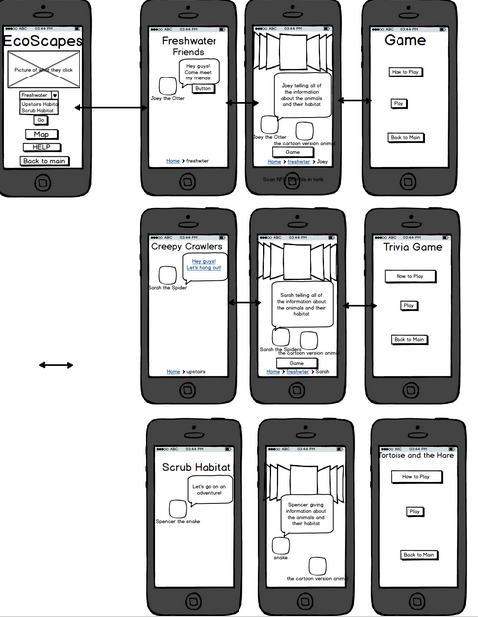
Preparation

Slide 4
Video Demo
Please visit youtube.com to view the video.

Slide 5
App Content
Main page, Slides, and Games
We have Joey the otter introducing each animal giving interesting information about that animal
The information is different from the information in the museum, we didn’t want to repeat the same information
There is a slide feature so that people can easily swipe through and find the animal they are looking.

Slide 6
Java Programming
In order to make the buttons and games work, the music play, and the popups come up, code was needed.
Integration of UI into the app so that everything would work as a whole.
Ensure that there were no “bugs” in the code so that the app would not crash on the tablet while in the hands of the user.

Slide 7
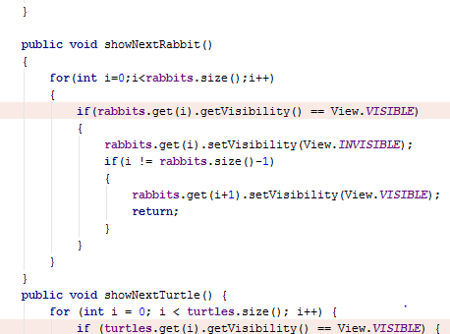
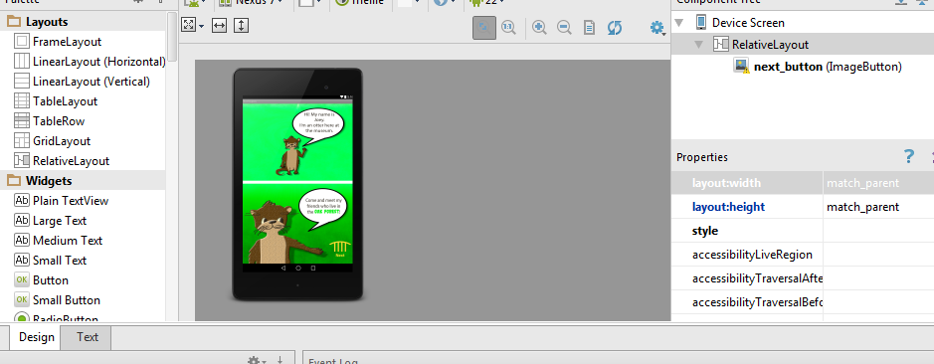
Examples of Code
Tortoise and the Hare Game
XML Layout

Slide 8
User Interface
We wanted to make each of the sections was different but uniform. So we chose 3 different colors: Blue (Freshwater), green (Oak forest), and orange (Scrub).
On each of the sections we have Joey the otter introducing the animals and we have him as buttons for the games.
On the background we had the colors form a light to dark gradient.
There is a back to main button on almost every page so when the user no longer wants to read about the animals, they can easily switch to another section.
We wanted everything to be clean, organized, and aesthetically pleasing.

Slide 9
Graphics
Joey the Otter
Tortoise and the Hare game
Comic Book Theme

Slide 10


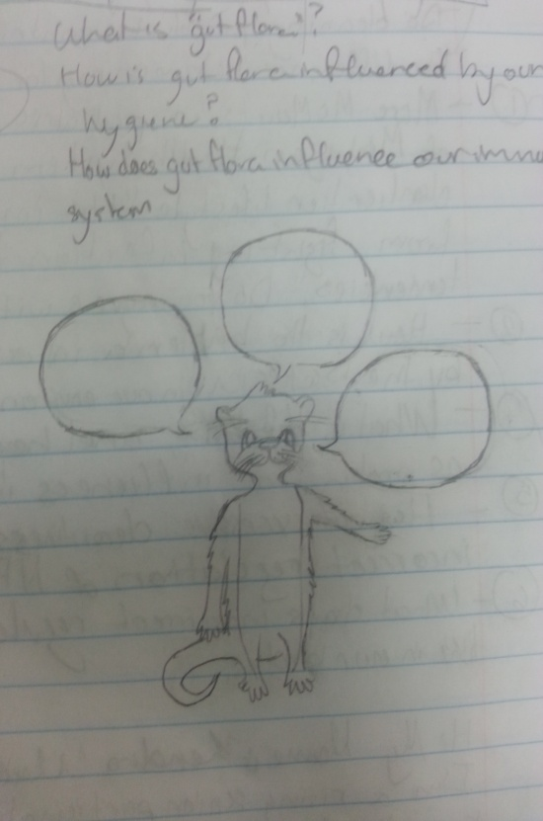
Pictures

Slide 11
Credits
The authors would like to give thanks to Nova and Cooper City High School for giving us the opportunity to participate in this amazing experience. We would also like to thank all Museum of Discovery and Science staff, especially Mrs. Summer Scarlatelli and Mr. Joe Cytacki, for their patience and assistance. Additionally, we would like to show our gratitude toward Dr. Ravi Shankar (Coding for Google Android) and Professor Francis McAfee (Graphics) and their teacher’s assistants which included Santiago Aguerreverre, Alain Edwards, and Demetrius Dukes who taught us so many new things and gave us an enormous amount of support at the Florida Atlantic University campus. Furthermore, we would like to reference Hello Android by Ed Burnette and Android Studio Development Essentials by Neil Smythe, as both of these books helped immensely in the coding process. Also, without the Adobe Photoshop program the graphics created for this app would not have been possible. Lastly, we would like to give special thanks to the United Way of Broward County for the grant that helped start the APPtitude program.

Slide 12
Photo Credits
Freshwater Aquariums
Channel Catfish Ictalurusnatalis.https://commons.wikimedia.org/wiki/File:Channel_Catfish.jpg
Blue Gill Lepomismacrochirushttps://ca.wikipedia.org/wiki/Fitxer:Bluegill_(lepomis_macrochirus).jpg
Fat Head Minnow Pimephalespromelashttps://commons.wikimedia.org/wiki/File:Fathead_minnow_-_breeding_male.jpg
Black Pacu Colossomamacropomumhttps://upload.wikimedia.org/wikipedia/commons/thumb/5/5f/Colossoma-brachypomus.jpg/300px-Colossoma-brachypomus.jpg
Scrub Habitat
Corn Snake Pantherophisguttatushttp://farm4.staticflickr.com/3060/3001574112_f9ffb73480_z.jpg?zz=1
Florida King Snake Lampropeltisgetulusfloridanahttps://upload.wikimedia.org/wikipedia/commons/1/1d/Speckled_king_snake_lampropeltis_getula_holbrooki_stejneger.jpg
Eastern Indigo Snake Drymarchoncouperihttps://upload.wikimedia.org/wikipedia/commons/2/2d/Indigo_snake_reptile.jpg
Florida Water Snake Nerodiafasciatahttp://farm8.staticflickr.com/7100/6890988212_2af33c2fbf_z.jpg
Gopher tortoise Gopheruspolyphemushttps://upload.wikimedia.org/wikipedia/commons/e/e9/Gopher_tortoise_in_Punta_Gorda,_Florida_2.jpg
Florida Box Turtle Terrapenecarolinabaurihttp://farm8.staticflickr.com/7294/8912913138_17866c1821_z.jpg
Eastern Box Turtle Terrapenecarolinacarolinahttps://upload.wikimedia.org/wikipedia/commons/2/27/Eastern_box_turtle_in_florida.JPG
Three-toed box turtle Terrapenecarolinatriunguishttp://www.birderslounge.com/wp-content/uploads/2009/07/20090615-AMC_2760-590x421.jpg
Old World Rabbit Oryctolaguscuniculushttps://c2.staticflickr.com/2/1224/536380994_ae786f2af5_z.jpg?zz=1
Forest Habitat
Egyptian Fruit Bat Rousettasaegyptiacushttps://c1.staticflickr.com/9/8519/8551127868_e095981f52_z.jpg
Day Gecko Phelsumahttps://upload.wikimedia.org/wikipedia/commons/d/d6/Madagascar_Giant_Day_Gecko.jpg
Madagascar Hissing Cockroach Gromphadorinaportentosahttps://upload.wikimedia.org/wikipedia/commons/4/46/Female_Madagascar_hissing_cockroach.JPG
Desert Blond Tarantula Aphonopelmachalcodeshttps://c1.staticflickr.com/9/8164/7560167682_a204c512e2_z.jpg
Pink Toe Tarantula Avicularia aviculariahttp://farm9.staticflickr.com/8260/8709022890_15da94f590_z.jpg
Curly-Hair Tarantula Brachypelmaalbopilosumhttp://media-cache-ec0.pinimg.com/736x/96/a8/b8/96a8b8fbea0300798abc1fc125871948.jpg
Red-kneed Tarantula Brachypelmasmithihttps://upload.wikimedia.org/wikipedia/commons/4/42/Mexican_Red_Knee_Tarantula_(Brachypelma_smithi).jpg
Tailless Whip Scorpion Damon sp.https://c2.staticflickr.com/6/5344/9621844031_84afcddda4_z.jpg
Flat rock Scorpion Hadogenes troglodyteshttps://upload.wikimedia.org/wikipedia/commons/thumb/6/68/Hadogenes_troglodytes.jpg/250px-Hadogenes_troglodytes.jpg
Asian forest Scorpion Heterometrus sp.http://farm9.staticflickr.com/8294/7802917594_008590bcbb_z.jpg
Red-claw Scorpion Opistophthalmuscarinatushttps://farm5.static.flickr.com/4107/5023385722_aea18ce26c_z.jpg
Emperor Scorpion Pandinus imperatorhttp://bugwoodcloud.org/images/768x512/5352017.jpg
Desert Millipede Orthoporus ornatushttps://c1.staticflickr.com/7/6150/5923493821_f170958809_z.jpg
Land hermit crab (soldier crab) Coenobitaclypeatushttps://c2.staticflickr.com/2/1069/868437853_72635c47ba_z.jpg?zz=1
Background sound credit: We would like to thank the tune Quirky Dog from Royalty Free Music.

Slide 13
Questions?

